Slide 1
Meeting Week 7
Last week summary
  Research plan
First principles baseline
  Provided matlab code of first-principles model
  Convert to python; compare frozen LTI to matlab
  LPV python implementation
    ZOH discretization
Question 1
Question 2
Outline ToDo next week

Slide 2
Last week summary
Meeting TU/e – ASMPT
  Discussed research plan
Discuss current research plan
  Mention what feedback has been incorporated
Some figure explaining the concept
When applicable, the same as will go in final report. Otherwise just take screenshots from relevant papers.

Slide 3
Last week summary
Meeting TU/e – ASMPT
  Discussed research plan
Discuss current research plan
  Mention what feedback has been incorporated
Vermelden mis research plan nog breder, beperkt met ruimte ipv als research plan goed gekeurd is introduction less page restrictions. Could be broader for grey box and other scheduling methods then LPV.
Some figure explaining the concept
When applicable, the same as will go in final report. Otherwise just take screenshots from relevant papers.

Slide 4
Research Plan – Background
Starts with ASMPT and advanced packaging as the application context.
Explains the dual-gantry challenge: coupling, position dependence, and flexible dynamics.
States that settling affects throughput because the system must wait for oscillations to decay before the next placement.
Describes the current ASMPT baseline and its limitation: partial position dependence, no systematic cross-coupling modelling.
Motivates grey-box modelling and states the gap as a missing validated framework that combines MIMO coupling, position dependence, and preserved interpretability.

Slide 5
Research Plan – Background Feedback
Shifted from general technical opening to ASMPT/application-first framing
Rephrased settling from speed-limited wording to waiting for oscillations before the next motion
Added broader value of plant models: digital twin, offline evaluation, control design, and condition monitoring
Made flexible dynamics explicit and clarified that cross-coupling matters for tracking as well as settling
Removed the earlier solution-first background style where LPV-LFR / augmentation details appeared too early.

Slide 6
Research Plan – Literature survey
Explains grey-box methods: parameter re-estimation, static correction, and dynamic augmentation.
Motivates dynamic augmentation because extra states are needed for flexible cross-coupling / position-dependent residual dynamics.
Explains why LPV / LPV-LFR is relevant and why LFR is used as a unifying structure.
Includes the negation problem and motivates orthogonal projection over simple parameter regularization.
Explains the validation choices: free-run simulation, BFR, held-out operating points, and unseen motion profiles.

Slide 7
Research Plan – Literature survey Feedback
Changed it from a source list into a section that also explains what each method is and why it is chosen
Added explicit motivation for dynamic augmentation instead of only naming it
Added explicit motivation for BFR and operating-point / motion-profile validation
Brought the negation / orthogonality reasoning into the literature survey instead of relying on the background
Added the hidden-state initialization issue for augmented models in simulation.

Slide 8
Research Plan – Research questions
RQ:
For the dual-gantry system, how should physics-based plant models be augmented to improve parameter interpretability and settling prediction accuracy, particularly of cross-coupling and position-dependent dynamics?

Slide 9
Research Plan – Research questions Aspects
1. Position-dependent baseline modeling
  In what form should the baseline model be represented for subsequent augmentation, and does position-dependent (LPV) formulation improve prediction compared to position-independent (LTI) alternatives?
2. Augmentation structure
  What augmentation structure can effectively capture dynamics not modeled in the physics based baseline model, in particular flexible cross-coupling dynamics?
3. Interpretability preservation
  How can parameter interpretability be maintained during data-driven augmentation, compared to unconstrained approaches? Here, interpretability means that the physical parameters of the baseline retain values close to their physically meaningful initialization after augmentation.
4. Model generalization
  How well does the augmented model generalize to (i) held-out operating points representative of actual industrial operating conditions and (ii) unseen motion profiles relevant to the industrial use context, and how does its prediction accuracy compare to a black-box state-space model trained on the same data?

Slide 10
Research Plan – Research questions Feedback
Moved the dual-gantry system to the front of the main RQ
Kept the four-aspect structure, but added black box comparison to Aspect 4
Kept augmentation and LPV-LFR in the RQ, but was now justified in the literature survey

Slide 11
Research Plan – AI&ES relevance
AI / data-driven learning: learning an augmented model from measured data to capture dynamics that are difficult to represent accurately in the first-principles baseline model, including flexible cross-coupling and position-dependent effects.
Engineering systems: embedding the learned augmentation within a physics-based LPVLFR plant model for a real dual-gantry system, accounting for coupling, scheduling dependence, and physical interpretability.

Slide 12
Research Plan – Research methods
Aspect 1 - Baseline modelling: convert the García-Herreros physics model to a discrete-time state-space baseline, reformulate it as quasi-LPV using payload position Y, and compare it against frozen LTI alternatives.
Aspect 2 - Augmentation structure: use a dynamic parallel LFR structure to capture residual behaviour that is not represented by the physics-based baseline, especially cross-coupling and flexible dynamics.
Aspect 3 - Interpretability preservation: apply orthogonal projection-based regularization so the learned component does not absorb dynamics already described by the baseline.
Aspect 4 - Generalization: validate on held-out operating points and unseen motion profiles, and compare prediction accuracy against a black-box state-space model trained on the same data.
Evaluation workflow: start with simulation-based validation, then evaluate on the ASMPT machine using BFR as the main fit metric.

Slide 13
Research Plan – Research method Feedback
Made Aspect 1 less low-level: removed detailed variable definitions, matrix-level model description, and experiment specifics, and kept the focus on baseline reformulation, discretization, and comparison
Added a clearer workflow: the plan now states that the baseline is first validated in simulation before evaluation on the real machine
Reframed discretization more carefully: ZOH is no longer presented as the discretization, but as an appropriate chosen LPV discretization technique
Strengthened validation: added an explicit black-box comparison baseline instead of comparing only against the physics-based baseline

Slide 14
Research Plan – Expected outcomes of the project
A validated LPV-LFR grey-box augmented model with better settling prediction than the baseline
Clarification of whether LPV outperforms frozen LTI
Clarification of whether orthogonal projection preserves interpretability in the LPV-LFR setting
A methodology that ASMPT can evaluate against current practice.Deliverables include models, code, validation scripts, and a documented workflow

Slide 15
Research Plan – Expected outcomes of the project Feedback
Removed plant inversion / feedforward controller design as future work for this project
  (Would shift the focus of the project)
Shifted the practical contribution toward a methodology ASMPT can evaluate and potentially develop further
Kept the focus on settling prediction, LPV vs LTI insight, and interpretability preservation

Slide 16
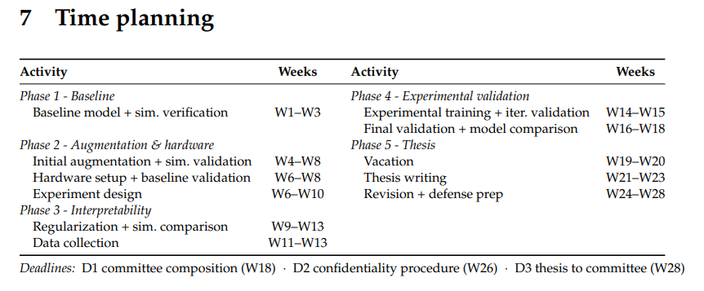
Research Plan – Time planning
Note: Hardware setup is when the dual-gantry arrives. I should potentially shift this back, because supervisors at ASMPT also have to get familiar with the hardware

Slide 17
Research plan - Update
Papers Roland
  I have not added the missing ones currently
  Multiple papers from Bas Kessels should I cite each separate or thesis?
In case of new comments should I turn in the research plan again?
  Or take this into account for the introduction?
  Or provide introduction instead, less page restricted

Slide 18
First-Principles Baseline
Received matlab FP implementation for the dual-gantry system
  Based on García paper
Goal:
  Implement in python for Jan’s augmentation code structure to replace the MSD (Frozen LTI)
  Apply ZOH discretization to convert to DT LPV-SS
    Verify with matlab CT output

Slide 19
First-Principles Baseline
Matlab setup:
  4 models called q, q1, q2, and q3
  The Simulink model runs q, q1, q2 simultaneously, each in its own closed loop under the same controller and reference trajectory. q3 lsim closed-loop response of the frozen discrete model.

Slide 20
Signal | What it is | M(Y) updating | Coriolis | Coulomb
q | Full physical simulation (Simscape): masses, joints, actuators and friction elements connected as a network. All nonlinear effects are included automatically, no manual simplification. | Yes | Yes | Yes
q1 | Simplified math model: equations of motion solved continuously by ode45, inertia M(Y) updated at every integration step, velocity-dependent nonlinear terms (Coriolis) not included | Yes | No | No
q2 | Same as q1 but with the Coriolis terms included | Yes | Yes | No
q3 | Frozen linear model: inertia fixed at Y = 0.3 m, stepped forward one sample at a time at 16 kHz, never updates with Y | No | No | No

Slide 21
Frozen LTI baseline – Python Implementation
Translated the MATLAB first-principles model into Python as a discrete-time state-space model. The inertia matrix M is evaluated once at the design operating point Y = 0.3 m and held constant: frozen LTI baseline.
Compared it to:
q3 (MATLAB lsim): the same frozen linear model run in MATLAB.
  Confirmation that Python translation is numerically identical to the MATLAB
q (Simscape): the full nonlinear physical simulation including Y-varying inertia, Coriolis, and Coulomb friction. Used as ground truth
  Identification of gap between linear and nonlinear model

Slide 22
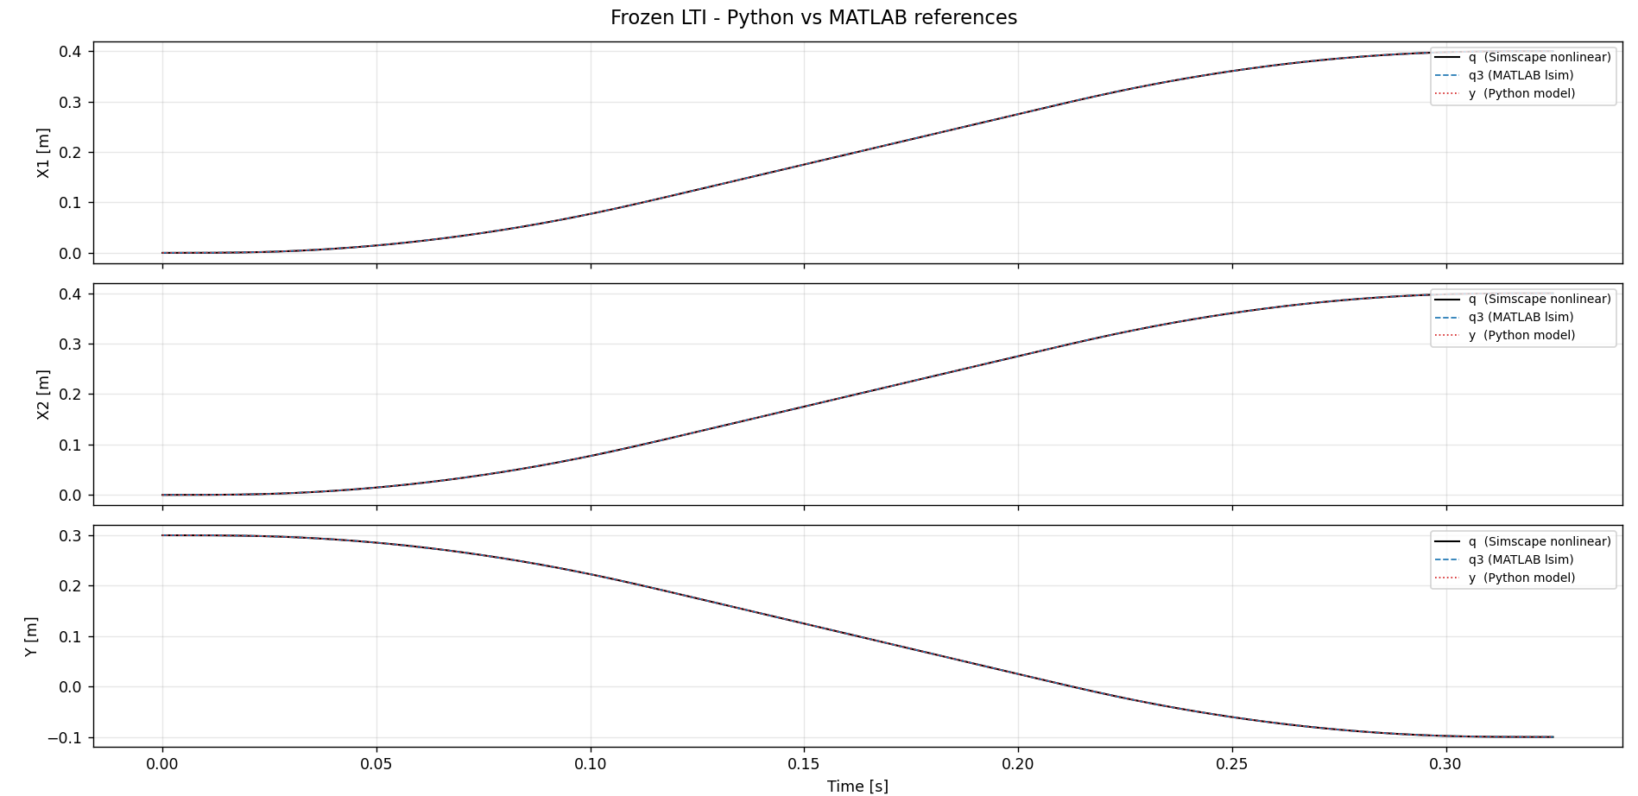

Slide 23
Frozen LTI baseline – Python implementation
Residuals (RMS and max absolute, in m):
y vs q3 [implementation check]:
X1 RMS=1.10e-13 m max=2.26e-13 m
X2 RMS=1.28e-13 m max=2.57e-13 m
Y RMS=7.46e-14 m max=1.24e-13 m
q3 vs q [linearisation gap] :
X1 RMS=4.86e-06 m max=1.62e-05 m
X2 RMS=3.19e-06 m max=1.11e-05 m
Y RMS=9.80e-08 m max=3.98e-07 m
y vs q [total error] :
X1 RMS=4.86e-06 m max=1.62e-05 m
X2 RMS=3.19e-06 m max=1.11e-05 m
Y RMS=9.80e-08 m max=3.98e-07 m

Slide 24
ZOH discretization validation
Compare against MATLAB's q1 (solves the same equations of motion continuously with ode45, updating M(Y) at every integration step)
  Since both models have identical physics (same M(Y), C, K; no Coriolis, no Coulomb), any residual between them is purely discretization error
  Isolates the ZOH implementation: allows me to verify ZOH
Requires PyTorch implementation to work with Jan’s augmentation code
Would it be possible to that I provide a document with the ZOH derivation to be checked?
  Including assumptions and math derivation

Slide 25
PyTorch implementation for ZOH
The core problem
When you train a neural network, PyTorch traces every computation and builds a graph of "who depends on what." At the end it walks backwards through that graph to compute gradients — this is backpropagation.
For that to work, every operation in the chain must be a PyTorch operation.

Slide 26
maybe i should do the following for the slide: Explain why i think it needs to be implemented in pytorch. Explain what I want to compare it to to verify the discretization was succesful: ZOH discretization validation with matlab ODE45 (~CT). Aks if I provide a document with the derivation and assumptions whether they will have time to verify it

Slide 27
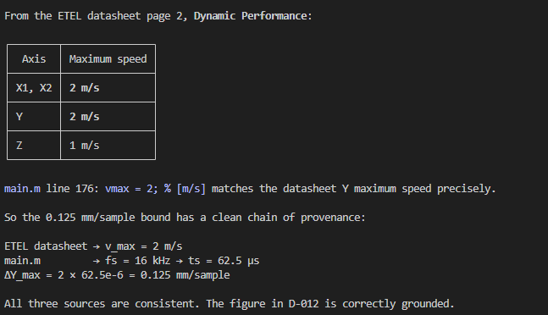
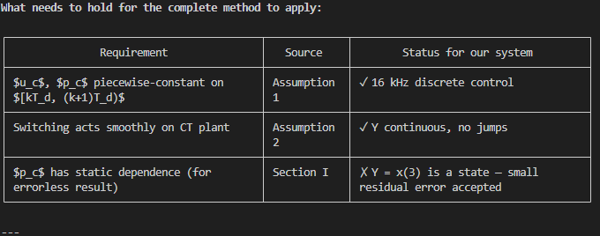
Conditions ZOH
For our system: Y changes at most ~0.125 mm per sample at 16 kHz — this is the "slowly and
smoothly" condition satisfied.

Slide 28
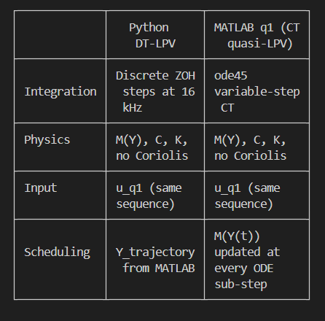
ZOH discretization validation with matlab ODE45 (~CT)
We use external scheduling (Y_schedule = MATLAB's Y_trajectory). This means A_d, B_d at each step
are frozen at MATLAB's Y values, not the Python
state's own Y. This is intentional — it isolates
ZOH error alone and removes a second
approximation (self-scheduling drift) that would
confound the result. It is the right approach for
this specific test.

Slide 29
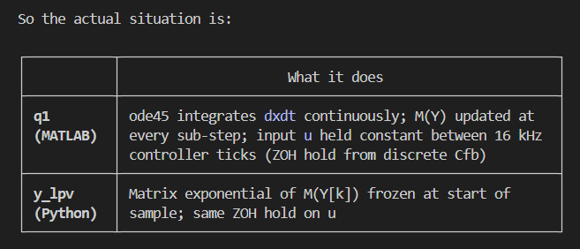
This is a sharp question. Let me look at exactly what q1 is before
answering.
gantrySystem.m returns dxdt = A*x + B*u — a derivative, not a
next-state. That means Simulink calls it as a continuous-time function
at every ode45 sub-step, with M(Y(t)) recomputed from the current state
x(3) at each sub-step.
So the actual situation is:
The comparison IS a valid ZOH proof, and here is why:
The ZOH formula (matrix exponential) computes exactly: "what is the
state after one sample if the input is held constant and the plant is
linear?" That is precisely what ode45 also computes for q1 — it
integrates the CT plant under a constant force for each 1/16000 s
interval.
The near-zero error shows these two methods (algebraic matrix
exponential vs numerical ode45 integration) agree, which confirms the
ZOH implementation is correct.
The one real approximation being made — which the near-zero error also
validates — is freezing M(Y[k]) for the whole sample interval, while
ode45 updates M(Y(t)) continuously within the interval. The fact that
error is sub-nanometre confirms this intra-sample variation of M is
negligible at 16 kHz (ΔY ≤ 0.125 mm per sample).
So yes: ZOH discretization is proven correct. The comparison is not
trivially comparing the model against itself — it is comparing two
different numerical methods (matrix exponential vs ode45 integration)
computing the same physical quantity.

Slide 30
To prove LPV beats frozen LTI: compare both against q1. To show the augmentation gap: compare LPV against q.
you say the simscape model is already able to capture that but we cant translate
it to state space, so then why are we not using the simscape model? because its not
a proper first principles model? explain to me please

Slide 31
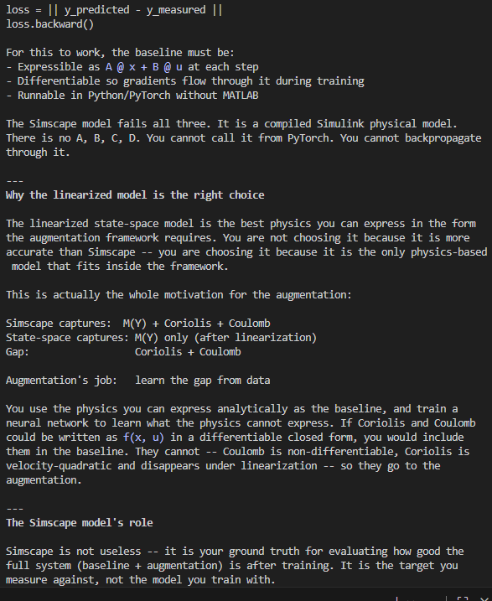
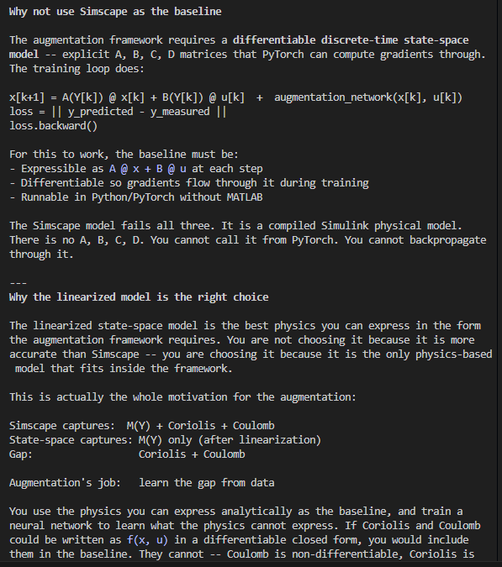

Slide 32
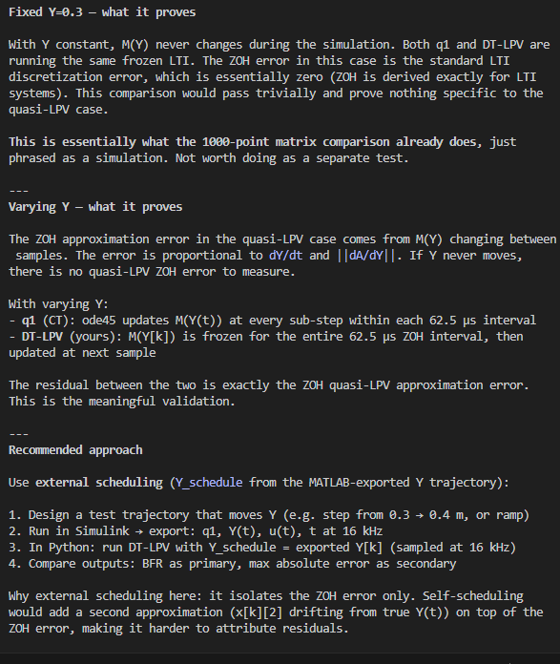
Show discretization error
With varying Y: - q1 (CT): ode45 updates M(Y(t)) at every sub-step within each 62.5 µs interval
- DT-LPV (yours): M(Y[k]) is frozen for the entire 62.5 µs ZOH interval, then updated at next sample

Slide 33
To discuss
Research plan and what changes I made based on the last meeting
First principles baseline
  Convert for augmentation structure
  FP frozen baseline. Compare with matlab result
  FP-LPV baseline. Toth methods
    Justify choosing direct ZOH discretization
Mention Jasper his proposal for adding a state to the existing FP baseline and try to capture this in the augmentation. Similar to Jan’s approach with MSD
  Will have to discuss with Jasper what state I would like to add.
Laten zien dat PyTorch zoh ondersteund
  Voorwaarden zoh toepassen en waarom PyTorch ondersteund en autograd.
Mis graphs laten zien voor vergelijking en error iig voor frozen baseline in python.
  Maar ook uitleggen wat ik vergelijk
  Zeggen G getransport en vergeleken met python output
Ff overzicht maken van welke design keuzes gemaakt, zie docs en decisions document

Slide 34
Duidelijk uitleggen waar in het process we nu zijn
Dus lpv baseline Frozen (plots en errors laten zien leg ook modellen uit waarmee ik het vergelijk matlab baseline)En lpv laten zien.

Slide 35
Vraag presentatie Hoe feedforward en feedback mee te nemen in simulatieRealistische motion profiles zullen ook bijgestuurd worden met ff, of is dat een extra verificatie stap?Jasper stelde rigid body ff voor

Slide 36
Issue scheduling real closed-loop hardware
What this does NOT establish:
Self-scheduling behaviour. When the model runs autonomously (no external Y), the Python Y state
drives the matrix selection. That is a separate
question tested by running the closed-loop
comparison, not this one.
Conclusion: Yes, the comparison is fair and establishes what we want. The near-zero residual
is not a tautology — the Python state evolves
from its own DT dynamics independently.
but in the physical system is it not possible
to use something like a kalman filter concept.
How sure we are that we are correct and how
correct the system output is?

Slide 37
--- When the complete method would NOT hold
The complete method requires $p_c(t)$ constant within $[kT_d, (k+1)T_d)$. For our system $p = Y =
x_3$ — a state. So within each interval, $Y$ actually evolves continuously as the integrator runs. The method breaks down when:
- Sample rate is low: at 100 Hz, $\Delta Y \leq 20\text{ mm}$ per sample. Freezing $Y$ at the start of the interval is a large error — $A_c(Y)$ at the end of the interval is substantially different. - Strong Y-sensitivity: if small $\Delta Y$ causes large changes in $A_c(Y)$ (e.g., near a
resonance that shifts fast with Y), the frozen approximation accumulates error quickly. - Y changes discontinuously: Assumption 2 violated — frozen $A_c(Y[k])$ would be wrong the moment
$Y$ jumps.
For our system none of these apply: 16 kHz gives $\Delta Y \leq 0.125\text{ mm}$, $A_c(Y)$ is smooth and slowly varying, Y is continuous. So the frozen approximation error is small — that is
the justification, not that the method is exact.
---
Why PyTorch autograd is needed
The complete method gives:
$$A_d = e^{A_c(Y),T_d}, \quad B_d = \left[\int_0^{T_d} e^{A_c(Y)\tau},d\tau\right] B_c(Y)$$ Both depend on $Y = x_3[k]$. In the training loop we simulate forward over $N$ steps and compute a loss $\mathcal{L}$ (prediction error). To train, we need:
$$\frac{\partial \mathcal{L}}{\partial \theta}$$
where $\theta$ includes physical parameters ($m_b, m_h, \ldots$) that live inside $A_c(Y)$. The gradient chain is:
$$\frac{\partial \mathcal{L}}{\partial \theta} = \frac{\partial \mathcal{L}}{\partial A_d} \cdot \frac{\partial A_d}{\partial A_c} \cdot \frac{\partial A_c}{\partial \theta}$$
The middle term — $\frac{\partial A_d}{\partial A_c} = \frac{\partial}{\partial A_c} e^{A_c T_d}$ — is the derivative through the matrix exponential.
- scipy.signal.cont2discrete: not in any autograd graph — gradient stops here - Naive formula $B_d = A_c^{-1}(A_d - I)B_c$: fails because our $A_c$ is singular
- torch.linalg.matrix_exp: differentiable, $A_c$ singularity is not a problem, gradient flows all
the way back to $\theta$ So autograd is not needed for the complete method itself to be valid — it is needed because we want to differentiate through the complete method during training.

Slide 38
--- When the complete method would NOT hold
The complete method requires $p_c(t)$ constant within $[kT_d, (k+1)T_d)$. For our system $p = Y =
x_3$ — a state. So within each interval, $Y$ actually evolves continuously as the integrator runs. The method breaks down when:
- Sample rate is low: at 100 Hz, $\Delta Y \leq 20\text{ mm}$ per sample. Freezing $Y$ at the start of the interval is a large error — $A_c(Y)$ at the end of the interval is substantially different. - Strong Y-sensitivity: if small $\Delta Y$ causes large changes in $A_c(Y)$ (e.g., near a
resonance that shifts fast with Y), the frozen approximation accumulates error quickly. - Y changes discontinuously: Assumption 2 violated — frozen $A_c(Y[k])$ would be wrong the moment
$Y$ jumps.
For our system none of these apply: 16 kHz gives $\Delta Y \leq 0.125\text{ mm}$, $A_c(Y)$ is smooth and slowly varying, Y is continuous. So the frozen approximation error is small — that is
the justification, not that the method is exact.
---
Why PyTorch autograd is needed
The complete method gives:
$$A_d = e^{A_c(Y),T_d}, \quad B_d = \left[\int_0^{T_d} e^{A_c(Y)\tau},d\tau\right] B_c(Y)$$ Both depend on $Y = x_3[k]$. In the training loop we simulate forward over $N$ steps and compute a loss $\mathcal{L}$ (prediction error). To train, we need:
$$\frac{\partial \mathcal{L}}{\partial \theta}$$
where $\theta$ includes physical parameters ($m_b, m_h, \ldots$) that live inside $A_c(Y)$. The gradient chain is:
$$\frac{\partial \mathcal{L}}{\partial \theta} = \frac{\partial \mathcal{L}}{\partial A_d} \cdot \frac{\partial A_d}{\partial A_c} \cdot \frac{\partial A_c}{\partial \theta}$$
The middle term — $\frac{\partial A_d}{\partial A_c} = \frac{\partial}{\partial A_c} e^{A_c T_d}$ — is the derivative through the matrix exponential.
- scipy.signal.cont2discrete: not in any autograd graph — gradient stops here - Naive formula $B_d = A_c^{-1}(A_d - I)B_c$: fails because our $A_c$ is singular
- torch.linalg.matrix_exp: differentiable, $A_c$ singularity is not a problem, gradient flows all
the way back to $\theta$ So autograd is not needed for the complete method itself to be valid — it is needed because we want to differentiate through the complete method during training.

Slide 39
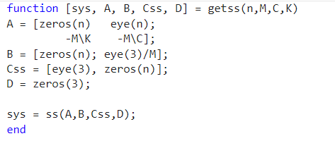
The integral for $B_d$ is:
$$B_d = \left[\int_0^{T_d} e^{A_c,\tau},d\tau\right] B_c$$
For an LTI system with invertible $A_c$, this integral has a closed form. Starting from the Taylor series of the matrix exponential:
$$\int_0^{T_d} e^{A_c,\tau},d\tau = \int_0^{T_d} \left(I + A_c\tau + \frac{A_c^2\tau^2}{2!} + \cdots\right)d\tau = T_d I + \frac{A_c T_d^2}{2!} + \frac{A_c^2 T_d^3}{3!} + \cdots$$
If $A_c$ is invertible, you can factor this as $A_c^{-1}(e^{A_c T_d} - I)$, giving:
$$B_d = A_c^{-1}(A_d - I),B_c$$
This is just an algebraic convenience — it avoids computing the integral directly by reusing $A_d$ you already have.
Why it fails for us: Our $A_c$ has the block structure:
$$A_c = \begin{bmatrix} 0 & I \ -M^{-1}K & -M^{-1}C \end{bmatrix}$$
The top-left $3\times3$ block is zero because of the rigid body modes in $K$ (the $X$ and $Y$ rows of $K$ are all zero — no restoring force). This makes $\det(A_c) = 0$, so $A_c^{-1}$ does not
exist. The formula is undefined.
The augmented matrix exponential avoids this entirely — it computes the integral $\int_0^{T_d} e^{A_c\tau}d\tau$ numerically via:
$$\exp!\left(\begin{bmatrix} A_c & B_c \ 0 & 0 \end{bmatrix} T_d\right) = \begin{bmatrix} e^{A_c T_d} & \left[\int_0^{T_d} e^{A_c\tau}d\tau\right]B_c \ 0 & I \end{bmatrix} = \begin{bmatrix} A_d &
B_d \ 0 & I \end{bmatrix}$$
No inversion of $A_c$ anywhere. This is exactly what scipy's cont2discrete(method='zoh') does internally, and what torch.linalg.matrix_exp replicates.
"To compute the resulting matrix functions of this discretization approach, Ac(p) is not required to be invertible, but if it is, we can write the resulting DT description of the state-evolution
conveniently as (9a)."

Slide 40
$B_d$ is the discrete-time input matrix — the $d$ stands for discrete.
The continuous-time system has:
$$\dot{x}(t) = A_c, x(t) + B_c, u(t)$$
where $B_c$ maps a continuous force input $u(t)$ to the state derivative at every instant in time.
The discrete-time system has:
$$x[k+1] = A_d, x[k] + B_d, u[k]$$
where $B_d$ maps a held force input $u[k]$ (constant over one sample interval $T_d = 62.5,\mu s$) to the next state $x[k+1]$. It answers: if I apply force $u[k]$ for one full sample period, how
much does the state change?
$B_d$ is not simply $B_c \cdot T_d$. It is the integral of the matrix exponential applied to $B_c$:
$$B_d = \left[\int_0^{T_d} e^{A_c,\tau},d\tau\right] B_c$$
This integral accounts for the fact that the state $x$ is moving throughout the interval — the force applied at the start has a different effect than the same force applied later in the
interval. The matrix exponential weights this correctly.
So the subscript convention throughout is simply: - $A_c,, B_c,, C_c,, D_c$ — continuous-time
- $A_d,, B_d,, C_d,, D_d$ — discrete-time

Slide 41
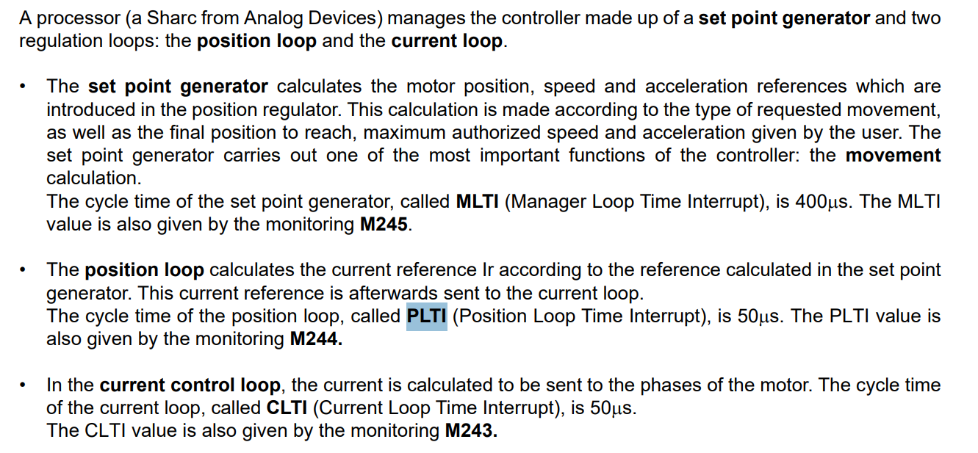
Etel telica sampling frecuency
Kamtin is a personalized variant of the telica for ASMPT

Slide 42
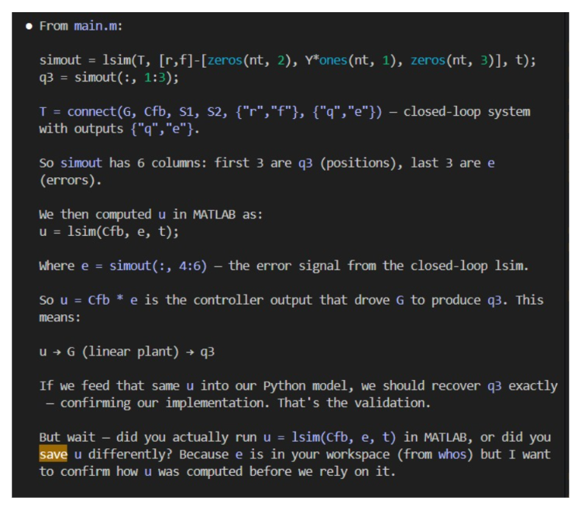

Slide 43
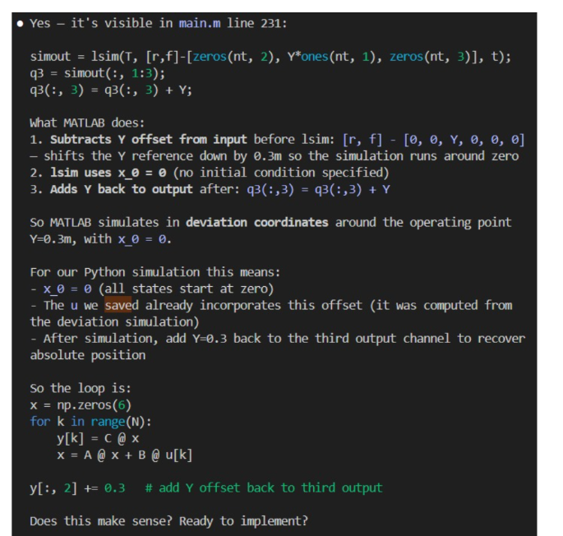
T_full = connect(G, Cfb, S1, S2, {"r","f"}, {"q","e","ufb"});simout_full = lsim(T_full, [r,f]-[zeros(nt,2), Y*ones(nt,1), zeros(nt,3)],t);u = simout_full(:, 7:9);save('C:\Users\20203253\OneDrive - TU Eindhoven\Graduation Project\Baseline FP model\Baseline-LPV-Augmentation\Matlab-output/gantry_input.mat', 'u', 'r', 't')

Slide 44
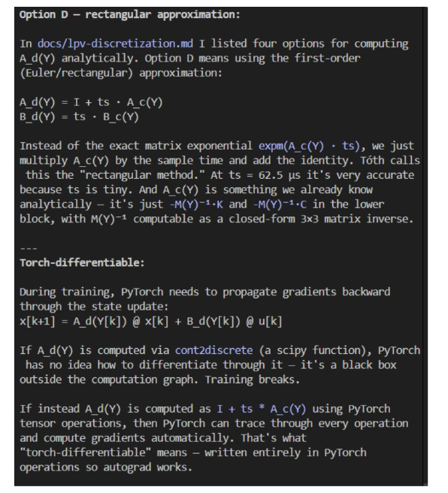
Because A_c(Y) contains M(Y)⁻¹, and M(Y) is a 3×3 polynomial matrix, its inverse is a ratio of polynomials — not a clean polynomial. This matters differently for each option.

Slide 45
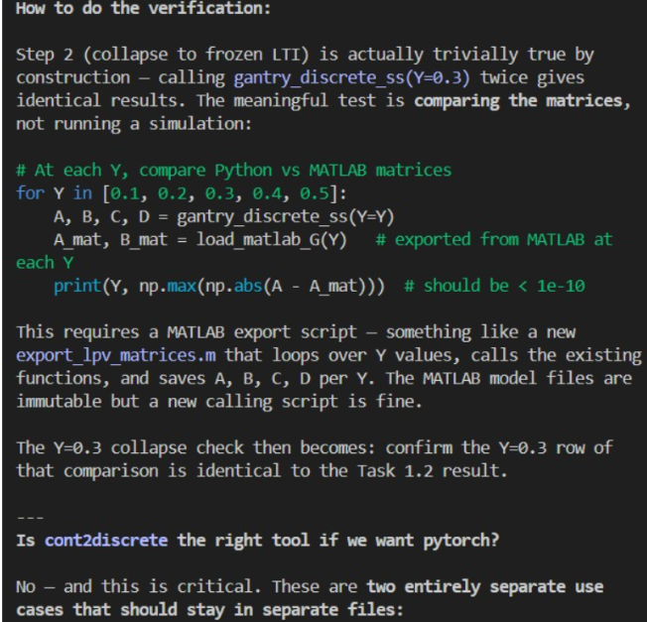

Slide 46
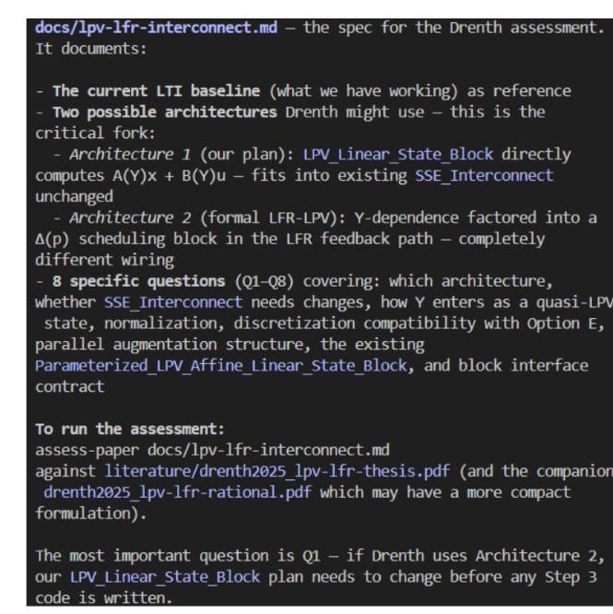

Slide 47
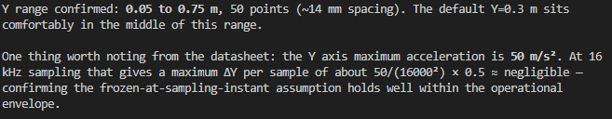

Slide 48
Action point 1
You should have a Gantt-chart or some other planning with what should be the next steps in the research.
Questions can also be put here
Some figure showing the result achieved like a plot or some theory.
When applicable, the same as will go in final report. Otherwise just take screenshots from relevant papers.

Slide 49
Vragen feedforward en feedback, belangrijk model?
  Voor realitische motion profiles?
Vraag aan het einde verwerken toth zijn papers. En andere feedback
Gewoon ff laten zien wat aangepast en huidige versie kort benoemen research plan.
Explain what each q is from matlab
Explain how it is obtained from the García paper FP baseline model I got
How to justify current methods over simpler metrics such as basis functions….

Slide 50
Feedforward and feedback simulation
  For realistic motion profiles need to take into account for simulation?
  Jasper suggested rigid body feedforward

Slide 51
First Principles Augmentation Verification
Jasper suggested creating two first-principles models.
Similar to how Jan validated his augmentation for the MSD
  Create simulation data by adding an extra state to the current FP-baseline
  Try to capture this extra state with the augmentation and verify that it correctly captures the state purely from data

Slide 52
Question 1
Should I include feedforward in the simulation alongside the feedback controller? Currently the simulation uses feedback only, meaning the residual between the baseline model and the nonlinear reference mixes model error (Coriolis, Coulomb, flexible dynamics) with control lag.
Including feedforward would make the residual a cleaner measure of model mismatch and the force profiles more representative of real machine operation
  (relevant for realistic motion profiles)
Jasper suggested rigid-body feedforward

Slide 53
Question 2 / Clarification
The dual gantry has Y-dependent dynamics (LPV)
The augmentation needs the delta p block so the learned correction can vary with Y
The FP-LPV baseline already recomputes A(Y), B(Y) from physics at each step
  so the delta p block is not needed for the baseline
Is this reasoning correct for if we include baseline parameter refinement during training?
  Then I don’t need to take this into consideration with my baseline verification

Slide 54
1. Training data realism: should the simulated baseline match how the real machine is operated (with feedforward), or is a feedback-only
baseline sufficient for learning the model mismatch?
2. What the network should learn: with feedforward the residual is
purely model error (Coriolis, Coulomb, flexible dynamics). Without it the residual mixes model error with control lag. The augmentation should ideally learn only the former.
3. Generalization: if the network trains on feedback-only data but the
real machine uses feedforward, the force profiles seen during training vs deployment differ — potential generalization issue.

Slide 55
Jasper (ASMPT) suggested using rigid body feedforward (F_ff = M(Y_ref) * a_ref) in the simulation. Should the baseline simulation include this to make the force profiles representative of real machine operation, or
should we keep feedback-only for now and address it when real
experimental data is available?

Slide 56
Drenth’s residual P-block
En wat als de augmentation ook de baseline parameters aan moet kunnen passen dan zorgen dat het samen werkt met drenth’s delta p block
Should I add this block also for the LPV baseline. Since the plan is to update the parameters of the First-Principles model aswel?

Slide 57
Design FP-LPV around augmentation architecture
I also wanted to discuss with you the structure we need for the fp-lpv
dt ss baseline in the augmentation model. because not only is jan his
augmenation code able to augment the structure by adding states, it
is also capable of better estimating the fp model parameters from the
baseline. but how does this work with lpv, should we still add a lpv
residual p block, similar to drenth for the fp baseline?

Slide 58
Outline next week
Work out discretization for FP model
Research plan?
Plan meeting TU/e – ASMPT
  ASMPT prefers a meeting every 4-6 weeks

